Slide 1
UFCFB3-30-1
Python (Basic Guide)
Web programming

Slide 2
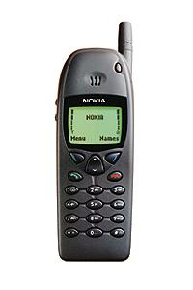
PLEASE turn off mobile phones etc.
X

Slide 3
This Lab session…
Quick intro to Python Basics
Compilation and Running Programs from Command Prompt
Practical Exercise
More Details in Lecture on Thursday

Slide 4
Getting Python
IMPORTANT
If you haven’t copied Python27 and Python34 folders on your memory stick then please do so and follow instructions from extended word document from last week practical session

Slide 5
A generic program structure
Declarations (Language dependent)
Library load
Global variables etc
Sub routines/functions
Program body
Variables
Business/program logic
Statements – assignments, method calls, input/output
Control structures – conditional/loops
Program Cleanup (Language dependent)

Slide 6
Python https://www.python.org/
In order to write your Python programs
Use Notepad++ or other similar editor. You may also use IDLE that is python IDE and comes with Python34
Type your program and save in a file with extension .py
You should save your programs in htdocs\webprog\ - Remember you created this directory in last week practical session.

Slide 7
Running a program …
You can either load \htdocs\webprog\ directory through Notepad++ OR by loading command prompt (or terminal window on Mac/Linux) and then using cd command i.e. cd X:\xampp\htdocs\webprog
please make sure you use correct drive letter i.e. X and directory names.
Please remember on Mac and Linux \ should be replaced with /
You can execute your program by typing
python progarmname.py
When you’re running python first time you may receive an error message that python command not found/unknown – This error is because of PATH environment variable - how to handle this error?
Solution 1: Type full path to python.exe i.e. X:\Python34\python filename.py
Solution 2: In Windows if you set up PATH variable by appending path to python executable (X:\Python34\python.exe) file. This will be useful if you’re running python from a local xampp folder on your hard disk not from USB memory stick!
Solution 3: Associate python.exe with all files having extension .py (not preferable solution)! Please make sure you associate correct version X:\Python34\python.exe

Slide 8
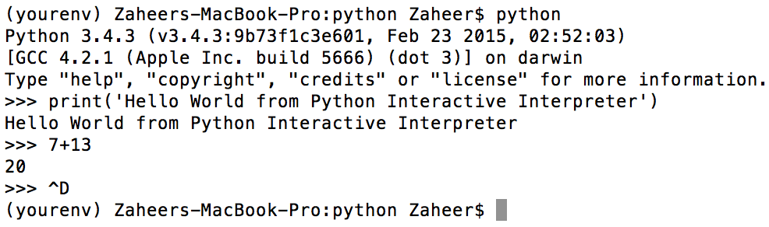
Compiling and Interactive Interpreter
Executing a python script
python filename.py
Make sure python is included in PATH
Compiling python program
python –m py_compile filename.py will generate corresponding filename.pyc file (byte code) that will execute in PVM (Python Virtual Machine)
Do check permissions in Linux or in XAMPP (chmod 755 for scripts)
Using Terminal or Command prompt
Source Code
Byte Code
PVM
Ctrl-D to exit from Interpreter mode
Or type exit() or Ctrl-Z and press enter
Source: http://www.python-course.eu/python3_execute_script.php
Notes:
python –c command [arg] ...
python –i script
read script first, then interactive

Slide 9
Running Python on Mac
For Mac users, you should have Python27 installed with your Mac OS X
Get Python34 - please see practical 1 extended notes
If you are in /Applications/XAMPP/htdocs/webprog folder and type python filename.py then by default it will be compiled using Python27
If you have installed Python34 then you may be able to run python3.4 from /usr/local/bin folder (but this may vary from one Mac to another)

Slide 10
Basics of Python Coding
Indentation matters
Block structure indicated by indentation e.g. body of a loop
Assignment to a variable creates it
Variable types don’t need to be declared.
Assignment creates references, not copies
Names in Python do not have an intrinsic type – it is automatically determined based on what data is assigned. But objects have types
Assignment is =
comparison is ==
For numbers + - * / % are as expected
Special use of + for string concatenation
Logical operators are words (and, or, not) - not logical operator symbols

Slide 11
Basic Python Constructs
Interactive Python
Python variables int, sequences e.g. string, list, dictionaries, sets etc
Loops – for, while
Conditional structures – if condition …
print statement – send something to output
input statement – read something
File handling – Reading/Writing
MySQL Database handling
Regular Expressions
Libraries - subroutines…
and CGI

Slide 12
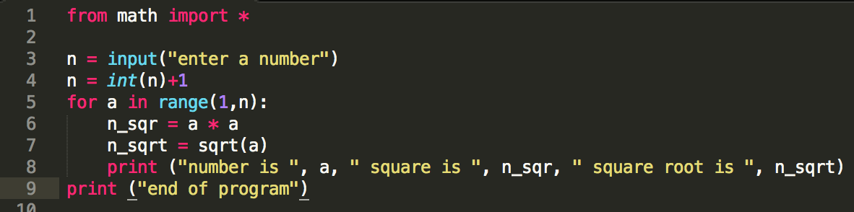
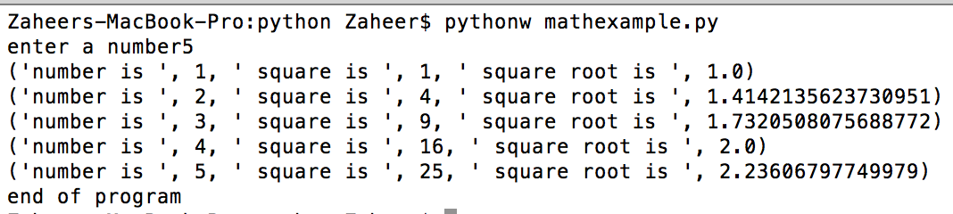
Indenting Code
Block 1
Block 2
Block 3
Block 2, continuation
Structured through indentation
i.e. code blocks are defined by their indentation, use of :
Makes it easier to read and understand Python code
Block 1, continuation

Slide 13
Simple Examples
Example 1
print (“Web Programming”)
Example 2
first = 1
second = 2
third = first + second
print (“Sum of ”, first, “ and “, second, “ is : ”, third)

Slide 14
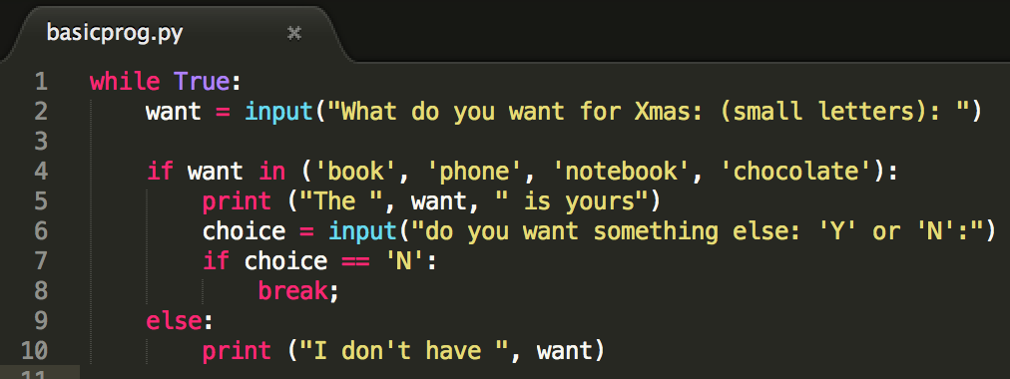
Simple Examples
I have one present to give –
Its from list of four things: if you ask for it you can have it – otherwise go without!
Notes:
while True:
want = input("What do you want for Xmas: (small letters): ")
if want in ('book', 'phone', 'notebook', 'chocolate'):
print ("The ", want, " is yours")
choice = input("do you want something else: 'Y' or 'N':")
if choice == 'N':
break;
else:
print ("I don't have ", want)

Slide 15
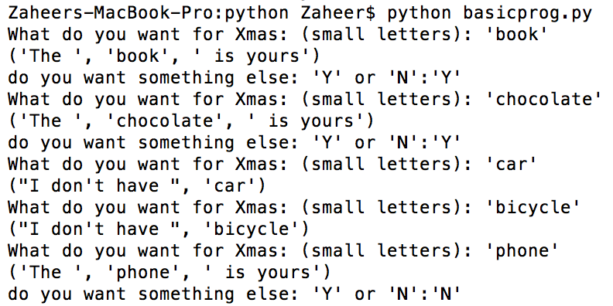
Output
Compiling and Running
Notice quotes

Slide 16
Try Python program examples…
Start with the following two exercises and after this download more exercises from Blackboard which will help you to prepare for in-class tests

Slide 17
Exercise 1
Print the following string in specific format
Python is an interpreted, object-oriented, high-level programming language with dynamic semantics. Its high-level built in data structures, combined with dynamic typing and dynamic binding, make it very attractive for Rapid Application Development, as well as for use as a scripting or glue language to connect existing components together. Python's simple, easy to learn syntax emphasizes readability and therefore reduces the cost of program maintenance. Python supports modules and packages, which encourages program modularity and code reuse. The Python interpreter and the extensive standard library are available in source or binary form without charge for all major platforms, and can be freely distributed.
Python is an interpreted, object-oriented, high-level programming language with dynamic semantics.
Its high-level built in data structures, combined with dynamic typing and dynamic binding, make it very attractive for Rapid Application Development, as well as for use as a scripting or glue language to connect existing components together.
Python's simple, easy to learn syntax emphasizes readability and therefore reduces the cost of program maintenance. Python supports modules and packages, which encourages program modularity and code reuse.
The Python interpreter and the extensive standard library are available in source or binary form without charge for all major platforms, and can be freely distributed

Slide 18
Exercise 2
Develop a small calculator. It should get two numbers from a user and perform one of the following operations: add, subtract, divide, multiply
Now after this its time to download more exercises from Blackboard which will help you to prepare for in-class tests

Slide 19
For more exercises
Have fun with with more exercises
http://www.practicepython.org/
Python – beginners guide for non-programmers
https://wiki.python.org/moin/BeginnersGuide/NonProgrammers
Python – beginners guide for programmers
https://wiki.python.org/moin/BeginnersGuide/Programmers

Slide 20
Online sources
Python Documentation: https://docs.python.org/3/
Python 3 Tutorial: http://www.python-course.eu/python3_course.php
Python School: http://www.pythonschool.net/basics/introduction-to-python/
Python2 to Python3: https://wiki.python.org/moin/Python2orPython3
Many other – tutorials etc -
The official python tutorial: http://docs.python.org/tutorial/
http://www.diveintopython.net/
http://www.tutorialspoint.com/python/index.htm
http://www.ibiblio.org/g2swap/byteofpython/read/
http://www.afterhoursprogramming.com/tutorial/Python/Overview/
http://www.pyschools.com/
http://learnpythonthehardway.org/
http://www.stavros.io/tutorials/python/
http://www.w3resource.com/python/python-tutorial.php
http://code.activestate.com/recipes/langs/python/
http://wiki.python.org/moin/PythonBooks

Slide 21
Books
Programming Python by Mark Lutz, O’Reilly. Published 31 Dec 2010
Python® Programming for the Absolute Beginner, Third Edition by Michael Dawson, Cengage Learning.
More Python programming for the absolute beginner Jonathan S. Harbour, Cengage Learning, c2012.
Learning Python by Mark Lutz (O’Reilly Media)
Python Essential Reference by David M. Beazley (Addison Wesley) Python Cookbook, ed. by Martelli, Ravenscroft and Ascher
Programming in Python 3: A Complete Introduction to the Python Language by Mark Summerfield (Addison Wesley)

